Slide 1
Information geometric regularization of the Barotropic Euler Equation
Florian Schäfer
Georgia Tech, School of Computational Science & Eng.
November 2023, Caltech

Slide 2


Information Geometric Regularization of the Barotropic Euler eqn.
Ruijia Cao
Cao, S, https://arxiv.org/abs/2308.14127

Slide 3
Compressible Euler Equations
Model frictionless barotropic gas dynamics
Velocity
Momentum
Conservation of mass and momentum
Density
External force
Pressure (increasing function)

Slide 4
Two Modes of Behavior
In one dimension:

Slide 5
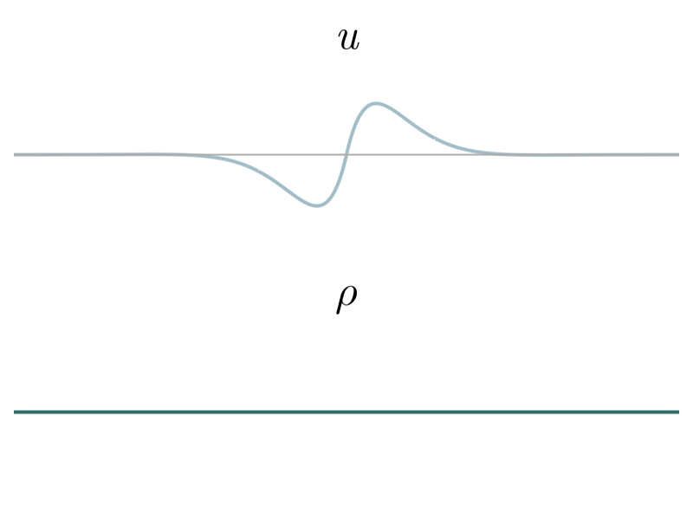

Two Modes of Behavior
Low velocity $⇒$ wave equation

Slide 6
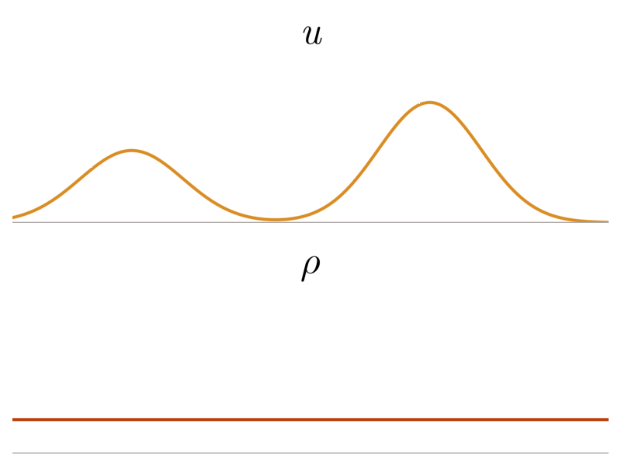

Two Modes of Behavior
High velocity $⇒$ momentum transport

Slide 7
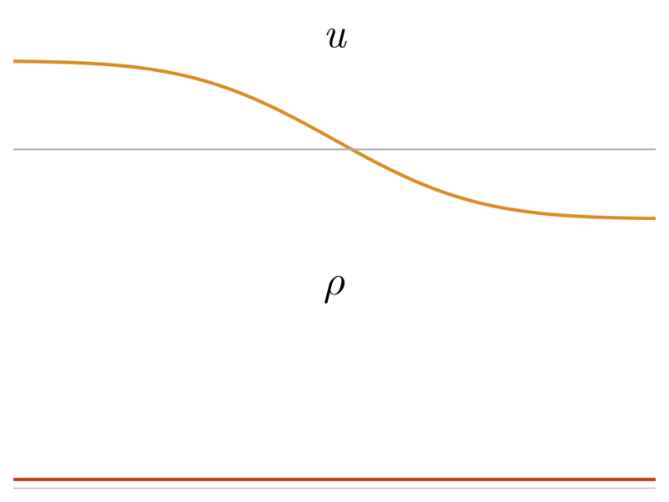
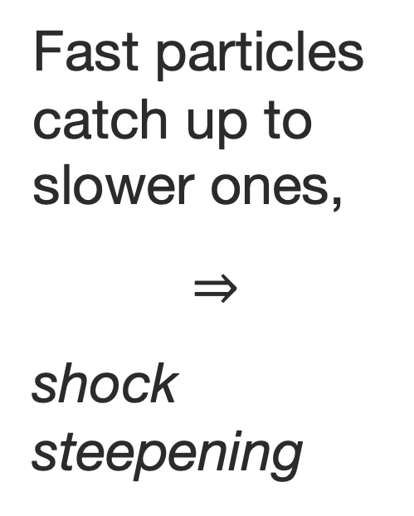
Shock Formation
Equations develop shock wave in finite time
Fast particles catch up to slower ones,
$$⇒$$
shock steepening

Slide 8
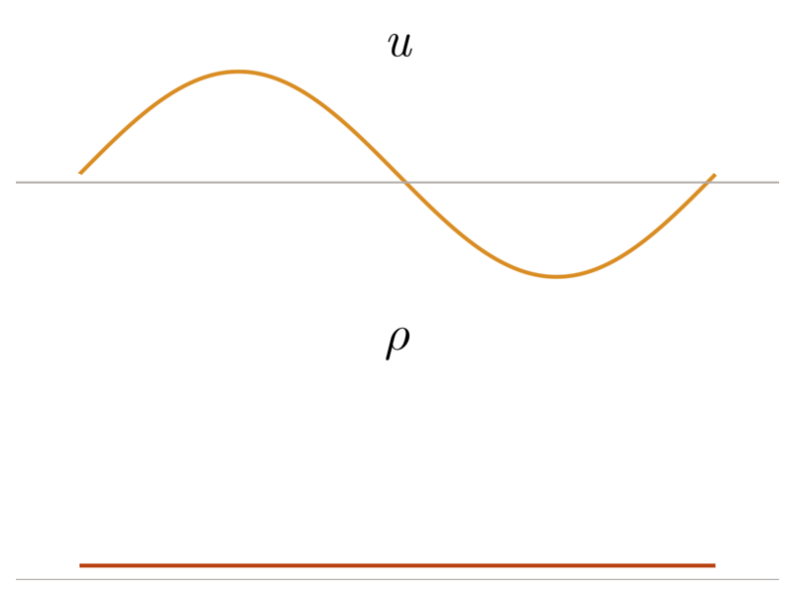
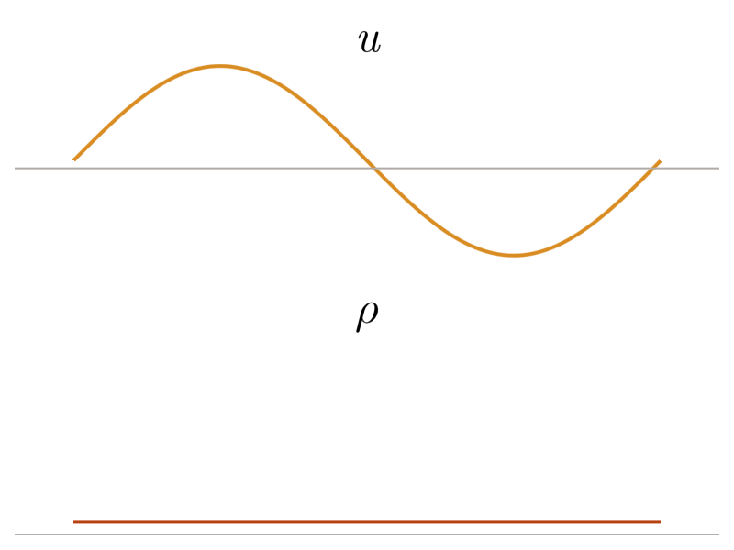
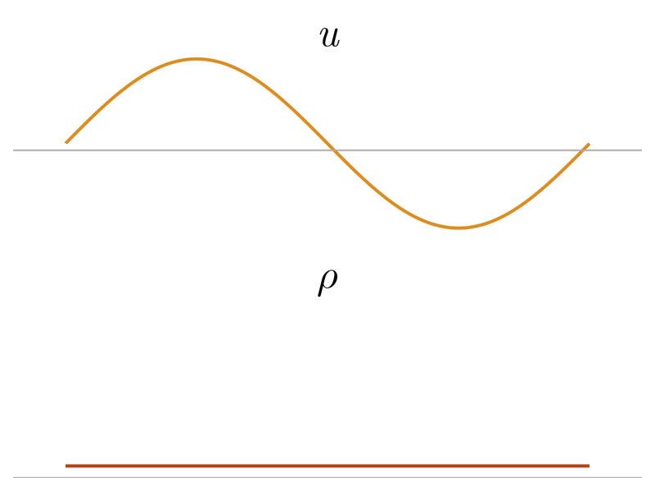

Vanishing Viscosity Solution
Solution from vanishing viscosity limit $ν→0$

Slide 9
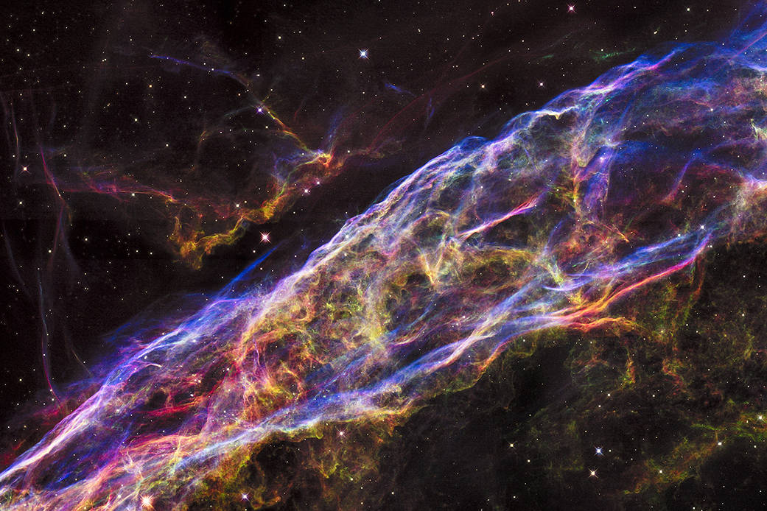
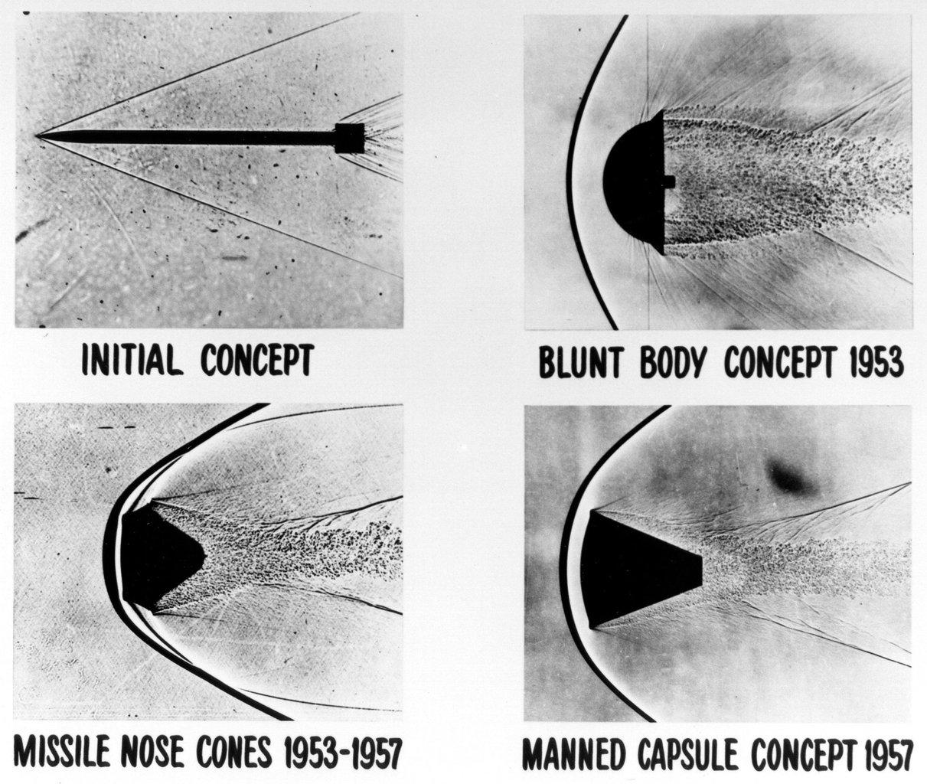
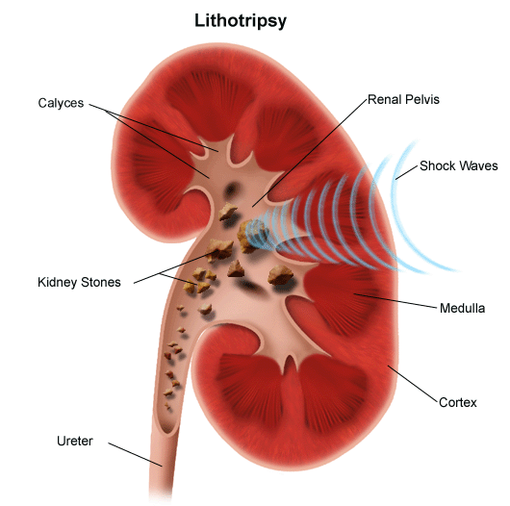
Shock Waves Everywhere!
Arise in:
- Astrophysics
Aerospace
Medicine
https://www.nasa.gov/image-feature/veil-nebula-supernova-remnant
https://en.wikipedia.org/wiki/Atmospheric_entry#/media/File:Blunt_body_reentry_shapes.png
https://www.hopkinsmedicine.org/health/treatment-tests-and-therapies/lithotripsy

Slide 10
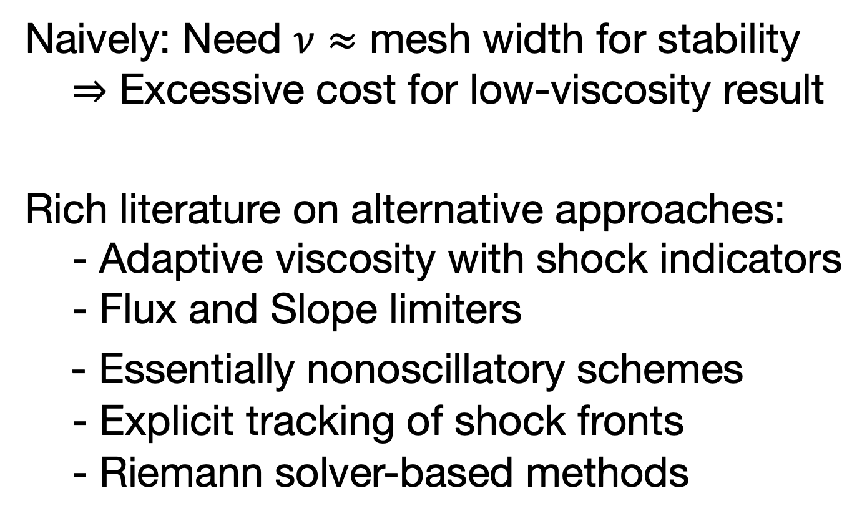
Difficulties and Approaches
Naively: Need $ν≈$ mesh width for stability
$⇒$ Excessive cost for low-viscosity result
Rich literature on alternative approaches:
- Adaptive viscosity with shock indicators
- Flux and Slope limiters
- Essentially nonoscillatory schemes
- Explicit tracking of shock fronts
- Riemann solver-based methods

Slide 11

Information Geometric Regularization (IGR)
IGR provides inviscid regularization of PDE
Regularizes geometry of manifold of deformation mappings
Note: $α≈h^{2}⇒$ no need for multigrid

Slide 12
IGR and diffusion
IGR provides inviscid regularization
Squinting a lot, can relate to viscous reg.

Slide 13
IGR vs LAD
Related: Localized Artificial Diffusivity (LAD)
[Cook & Cabot 2005, Kawai & Lele 2008, Mani et al. 2009] and others
IGR:
LAD:
“Viscosity” nonlocal, nonpositive, nonsymmetric

Slide 14
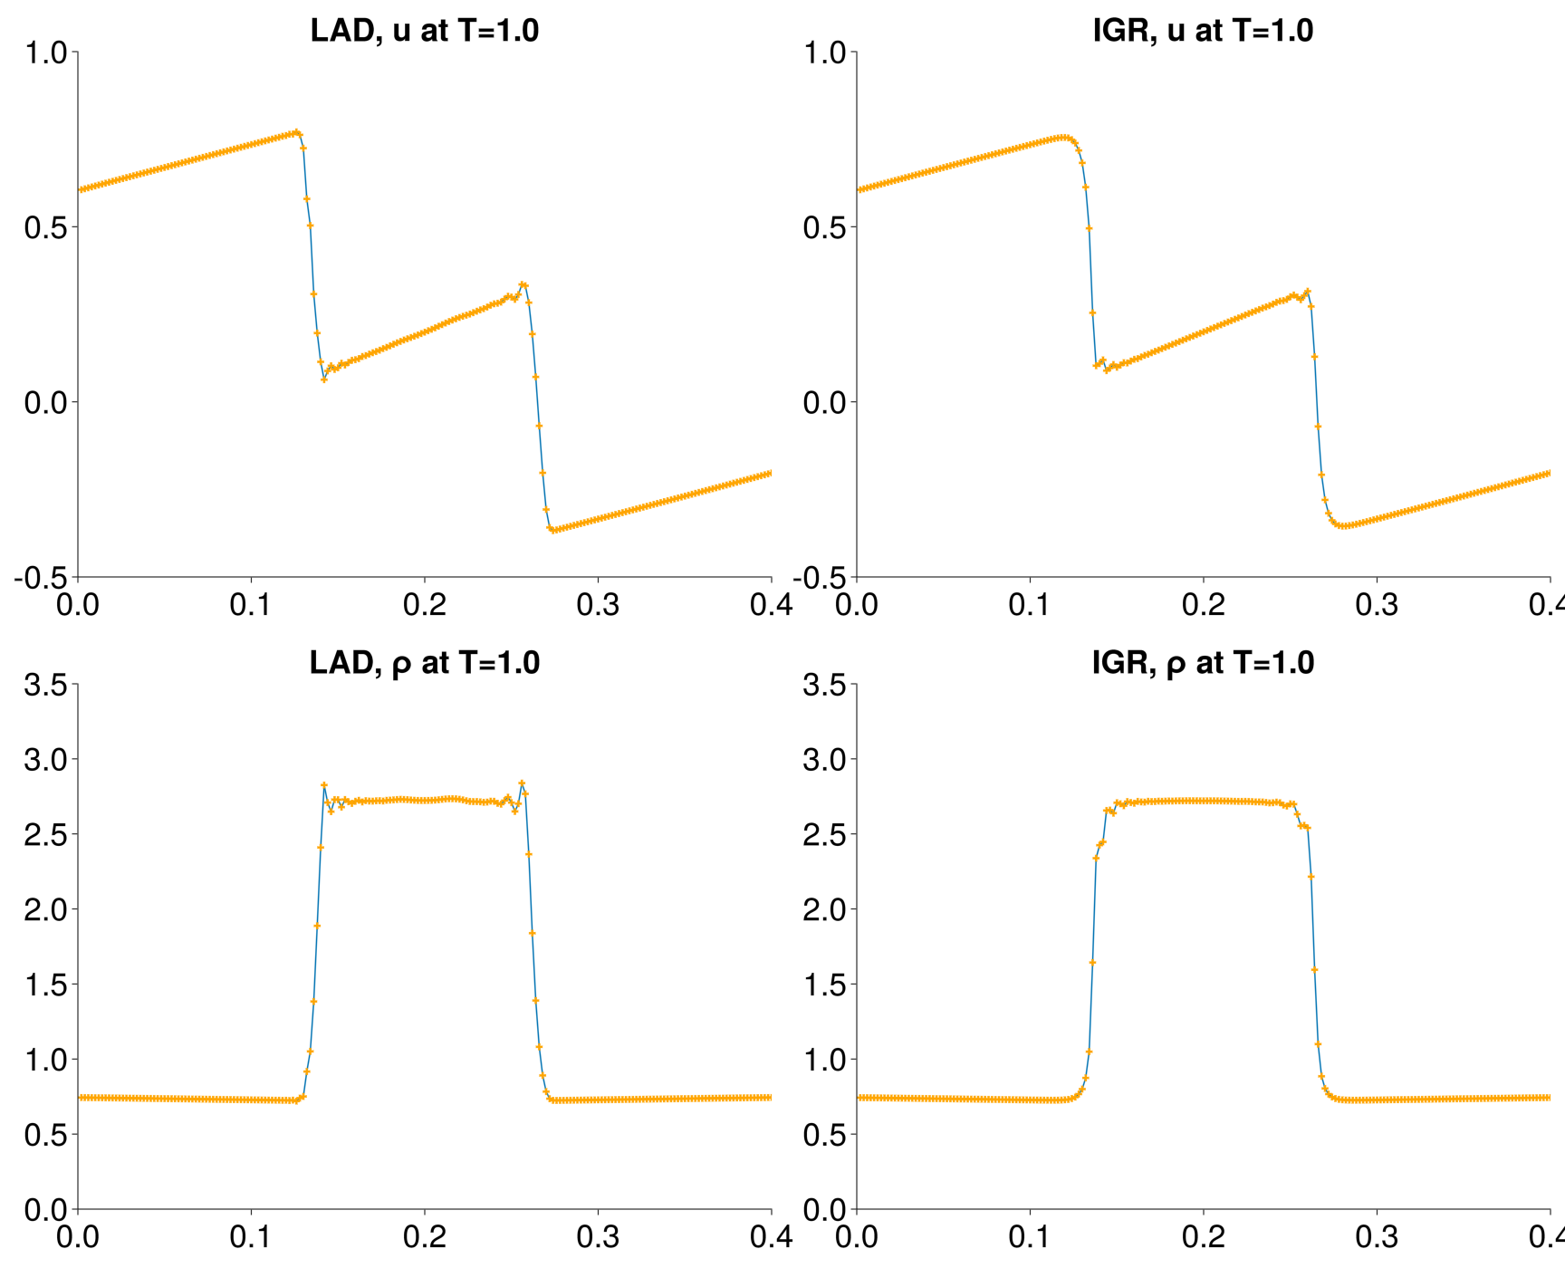
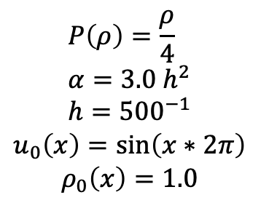
Nonlocality reduces oscillation
$$P\left(ρ\right)=\frac{ρ}{4} \\ α=3.0 h^{2} \\ h={500}^{−1}$$
$$u_{0}\left(x\right)=\sin\left(x∗2π\right)$$
$$ρ_{0}\left(x\right)=1.0$$

Slide 15
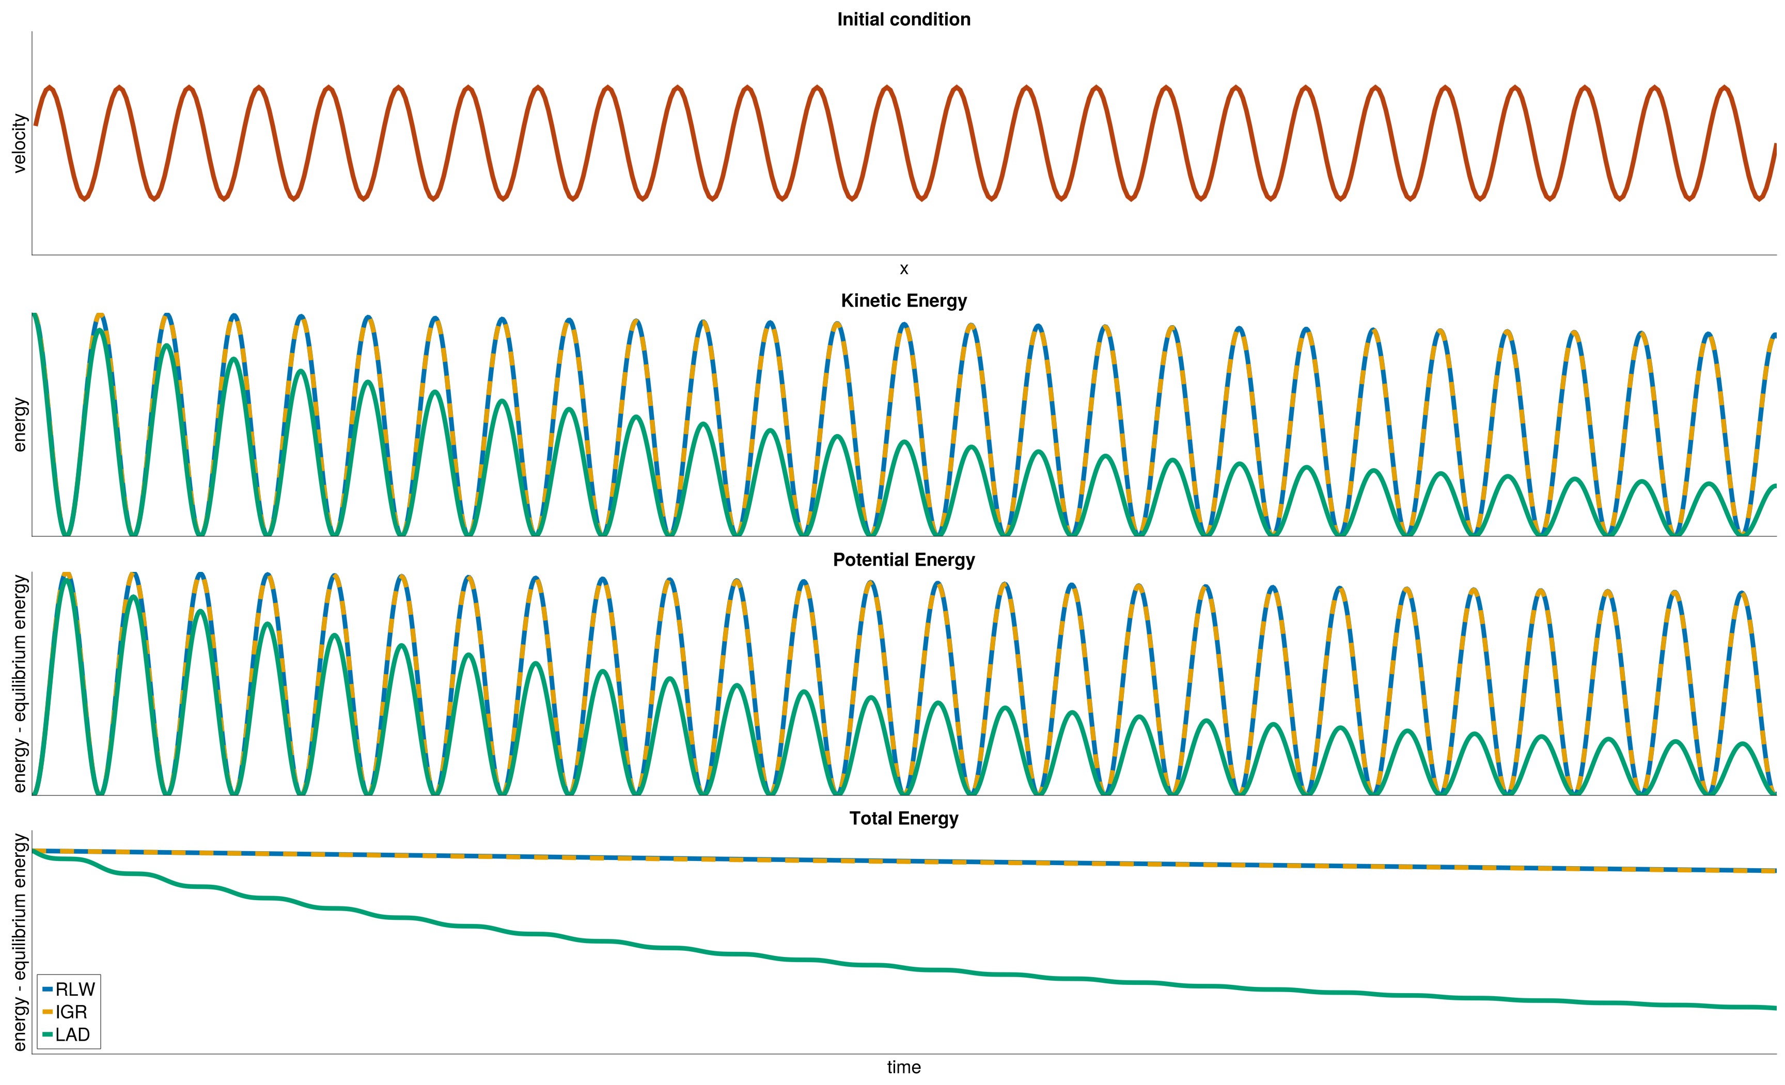
Nonpositivity reduces dissipation
$$P\left(ρ\right)=20ρ^{1.4}, α=50 h^{2}, h={500}^{−1}, u_{0}\left(x\right)=\frac{1}{25}\sin\left(25 x ∗2π\right), ρ_{0}\left(x\right)=1.0$$

Slide 16

Model: Burgers Equation
To simplify study of shocks: set $P, f≡0$

Slide 17
Model: Burgers Equation
To simplify study of shocks: set $P, f≡0$

Slide 18
Model: Burgers Equation
To simplify study of shocks: set $P, f≡0$

Slide 19
Model: Burgers Equation
To simplify study of shocks: set $P, f≡0$

Slide 20
Model: Burgers Equation
To simplify study of shocks: set $P, f≡0$

Slide 21

Method of Characteristics
Consider family of straight lines
And define
Then $u$ satisfies Burgers’ equation, since

Slide 22
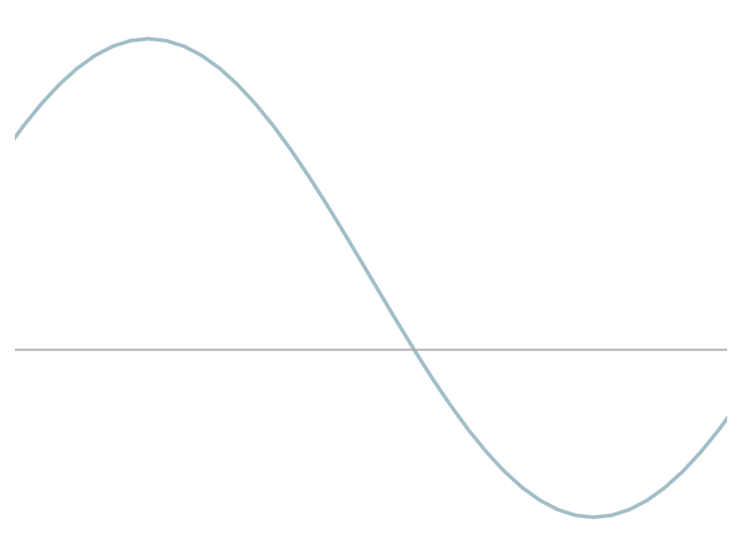
Crossing Characteristics
Shocks form when characteristics cross.

Slide 23
Rankine-Hugoniot Condition
How to continue the paths after crossing?
In vanishing viscosity solutions, they merge.
Rankine-Hugoniot:
Burgers characteristics are sticky balls!

Slide 24

Constrained Optimization & PDEs
Change of basis reveals constraint set
Rankine-Hugoniot $≈$ projected GD for $\min_{x_{2}≥0}{x⋅v}$

Slide 25
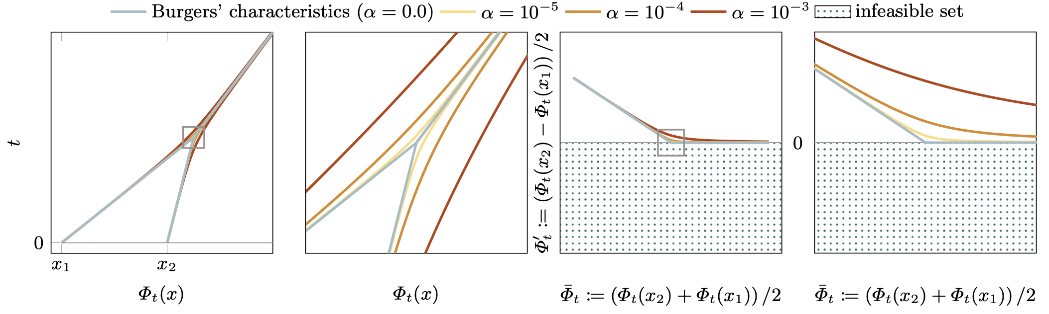
Interior Point Methods for PDEs
Modify eqn. so that ch. curves never cross?
In optimization: Barrier functions and interior point methods (ITPs).

Slide 26
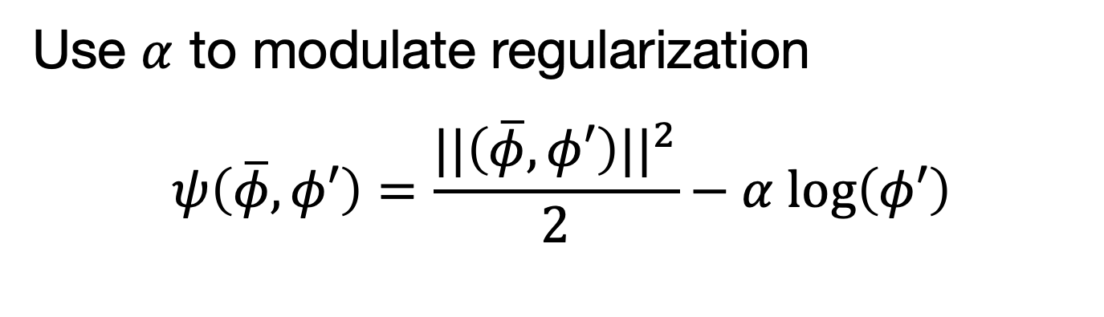
Choosing a Barrier
Use $α$ to modulate regularization
$$ψ\left(\overline{φ}, φ′\right)=\frac{||\left(\overline{φ}, φ′\right)||^{2}}{2}−α log\left(φ′\right)$$

Slide 27
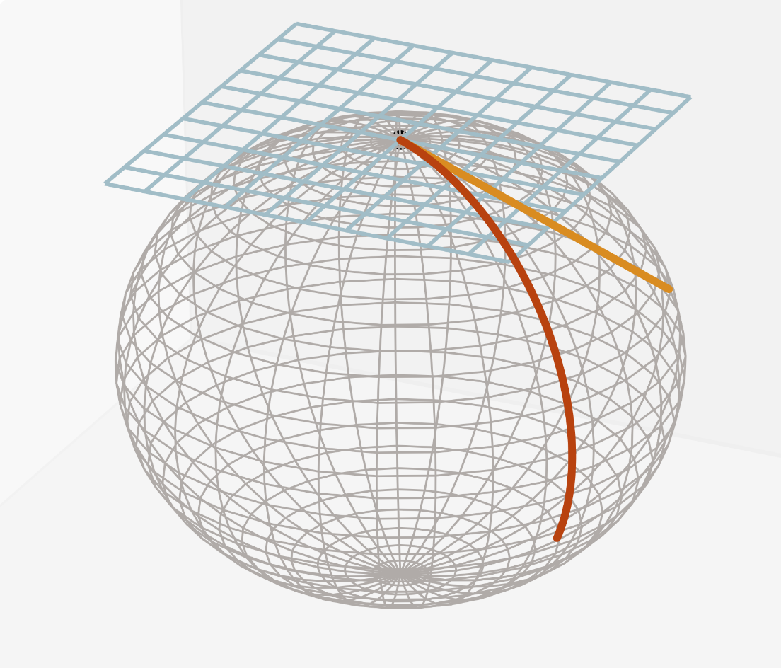
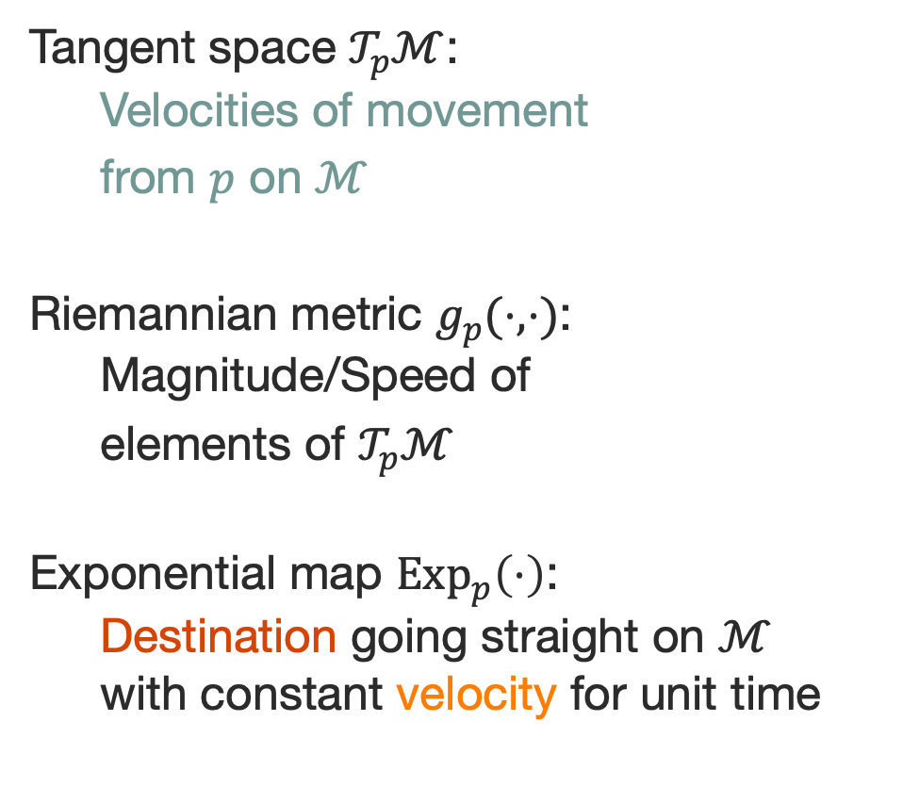
Notions of Differential Geometry
Tangent space $𝒯_{p}ℳ$:
Velocities of movement
from $p$ on $ℳ$
Riemannian metric $g_{p}(⋅,⋅)$:
Magnitude/Speed of
elements of $𝒯_{p}ℳ$
Exponential map ${Exp}_{p}\left(⋅\right)$:
Destination going straight on $ℳ$
with constant velocity for unit time

Slide 28
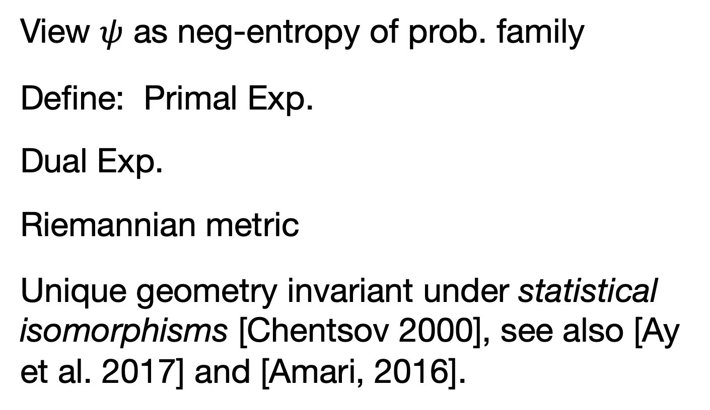
Information Geometry
View $ψ$ as neg-entropy of prob. family
Define: Primal Exp.
Dual Exp.
Riemannian metric
Unique geometry invariant under statistical isomorphisms [Chentsov 2000], see also [Ay et al. 2017] and [Amari, 2016].

Slide 29

Information Geometry of $ψ$
Solution Paths of ITPs are dual geodesics
[Amari 2016], also [Nesterov & Todd, 2002]
Replace characteristics with dual geodesics

Slide 30
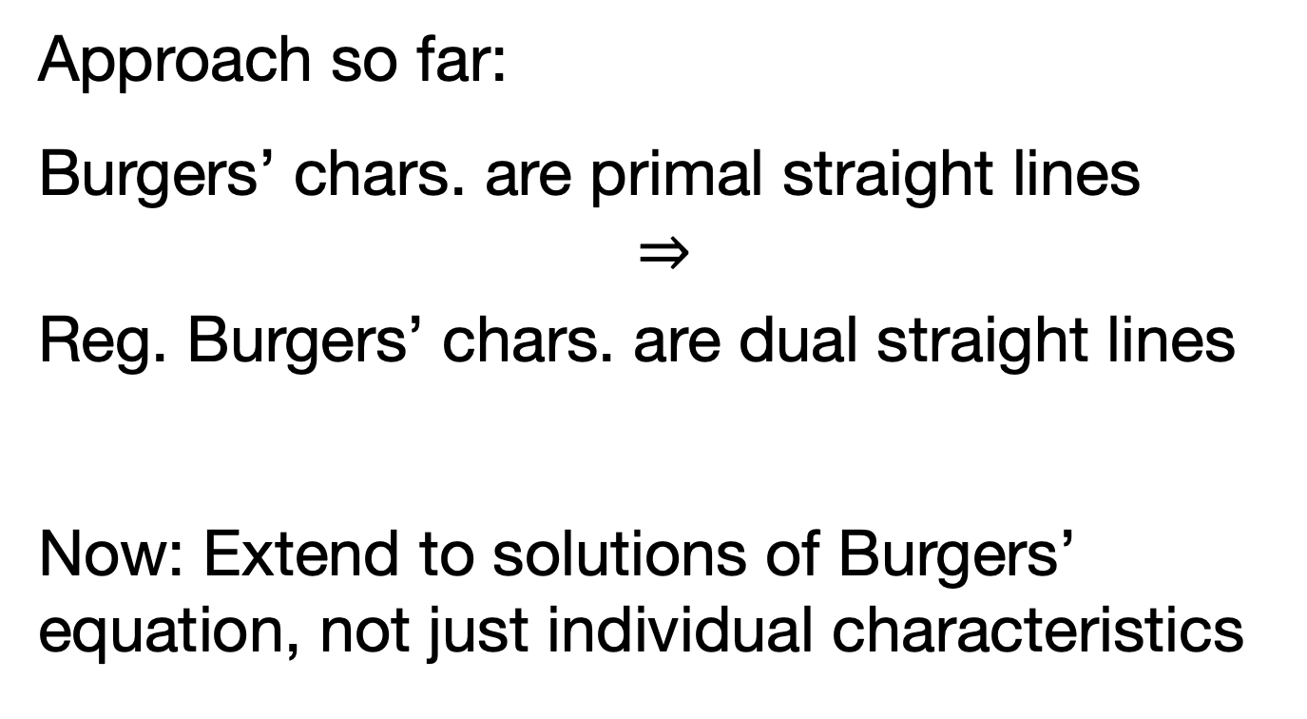
The infinite dimensional case
Approach so far:
Burgers’ chars. are primal straight lines
$$⇒$$
Reg. Burgers’ chars. are dual straight lines
Now: Extend to solutions of Burgers’ equation, not just individual characteristics

Slide 31
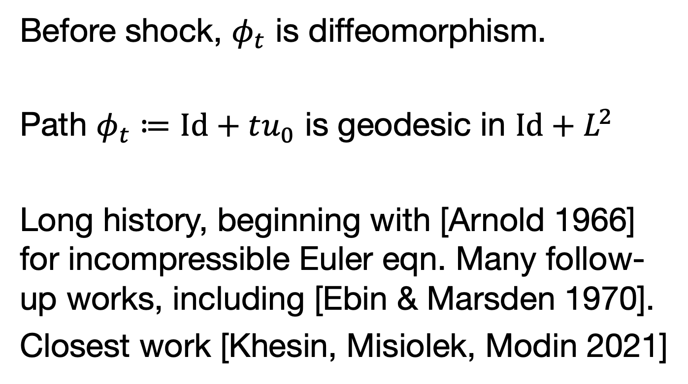
Geodesics of Diffeomorphisms
Before shock, $φ_{t}$ is diffeomorphism.
Path $φ_{t}≔Id+tu_{0}$ is geodesic in $Id+L^{2}$
Long history, beginning with [Arnold 1966] for incompressible Euler eqn. Many follow-up works, including [Ebin & Marsden 1970].
Closest work [Khesin, Misiolek, Modin 2021]

Slide 32
Geodesics of Diffeomorphisms
When shocks form: Leave diffeomorphisms

Slide 33
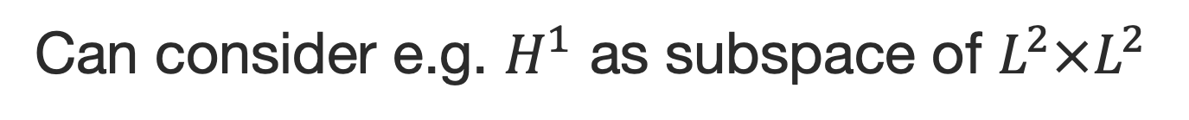
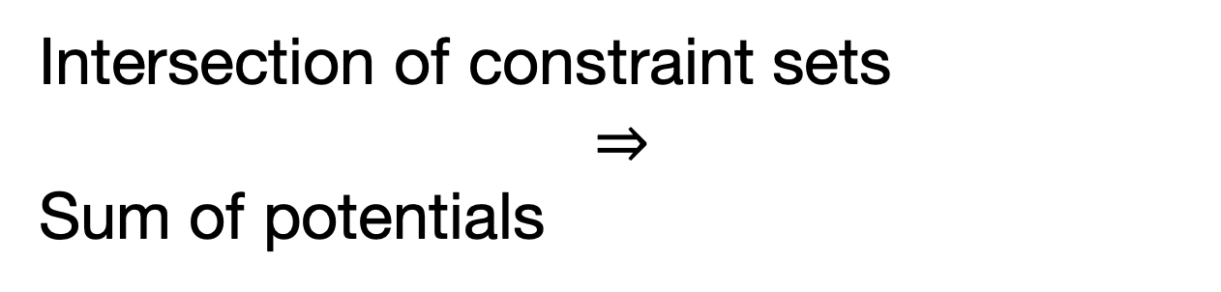
Designing the ambient space
Can consider e.g. $H^{1}$ as subspace of $L^{2}×L^{2}$
Intersection of constraint sets
$$⇒$$
Sum of potentials

Slide 34
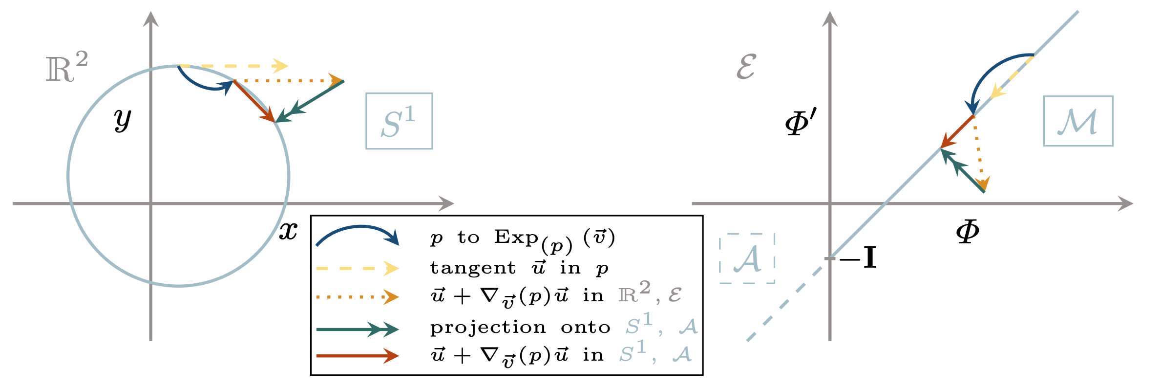
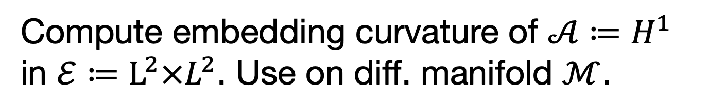

Dual parallel transport on $Diff$
Compute embedding curvature of $𝒜≔H^{1}$ in $ℰ≔L^{2}×L^{2}$. Use on diff. manifold $ℳ$.
Elliptic Problem projects onto tangent space

Slide 35

Time to compute…
Start with derivative
Resulting $L^{2}$ gradient

Slide 36

Time to compute…
Hessian as quadratic form:
As map from $L^{2}$ onto itself:

Slide 37

Time to compute…
Third derivative as cubic form:
As map from $L^{2}×L^{2}$ onto $L^{2}$:

Slide 38
Ambient parallel transport
Combine for ambient parallel transport:

Slide 39
Projection
Need to project back onto tangent space
Optimality condition is elliptic PDE

Slide 40
The Geodesic Equation
The geodesic equation is given by
Using the dual parallel transport:

Slide 41

In Eulerian Coordinates
Want description in Eulerian form. Define
Plug into parallel transport PDE.
Express $∂_{x}F$ in terms of Eulerian density

Slide 42
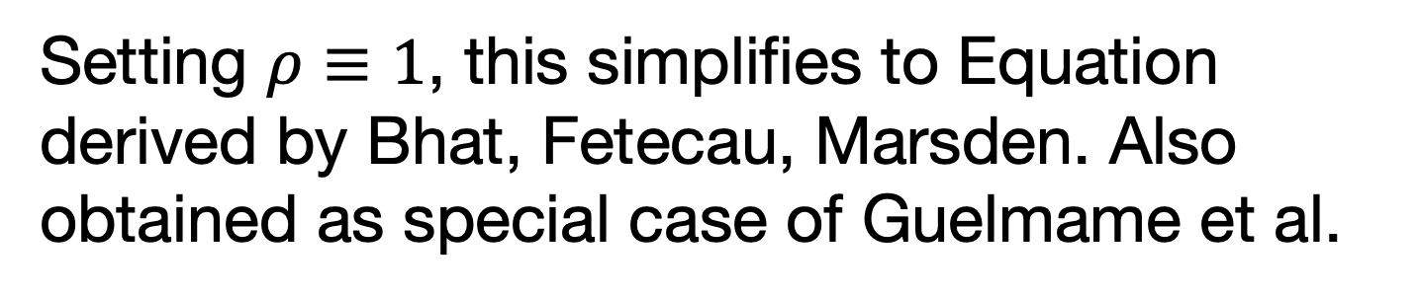
The regularized Burgers’ Eqn.
Finally obtain the regularized equation
Defining
simplify to
Setting $ρ≡1$, this simplifies to Equation derived by Bhat, Fetecau, Marsden. Also obtained as special case of Guelmame et al.

Slide 43
Conservation Law and Euler
Want equation in conservation form
Can rewrite as
Add pressure term as needed

Slide 44
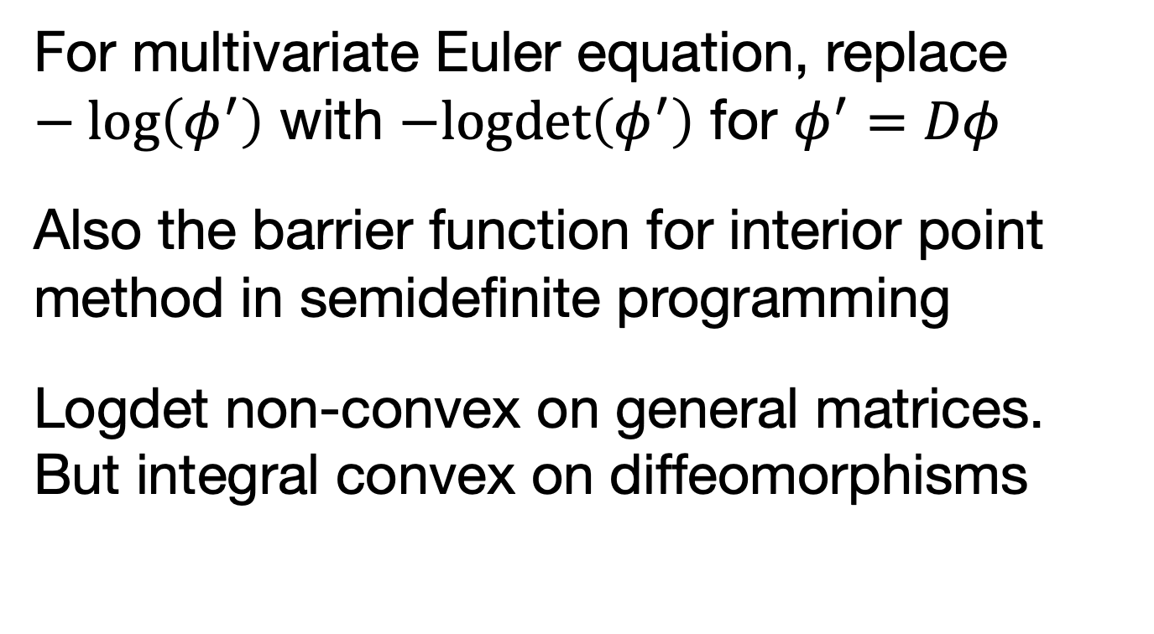
Extension to Multivariate case
For multivariate Euler equation, replace $−\log\left(φ^{′}\right)$ with $−logdet\left(φ^{′}\right)$ for $φ^{′}=Dφ$
Also the barrier function for interior point method in semidefinite programming
Logdet non-convex on general matrices. But integral convex on diffeomorphisms

Slide 45
Summary & Why am I here?
Propose inviscid information geometric regularization for flows with shocks
Improvements over viscous equation-based shock capturing in multiphase flow?
Multiphase problems help understand IGR (contact problem vs. entropic regularization)

Slide 46
Some numerics: Burgers
Regularized Burgers’eqn avoids oscillations without numerical viscosity

Slide 47
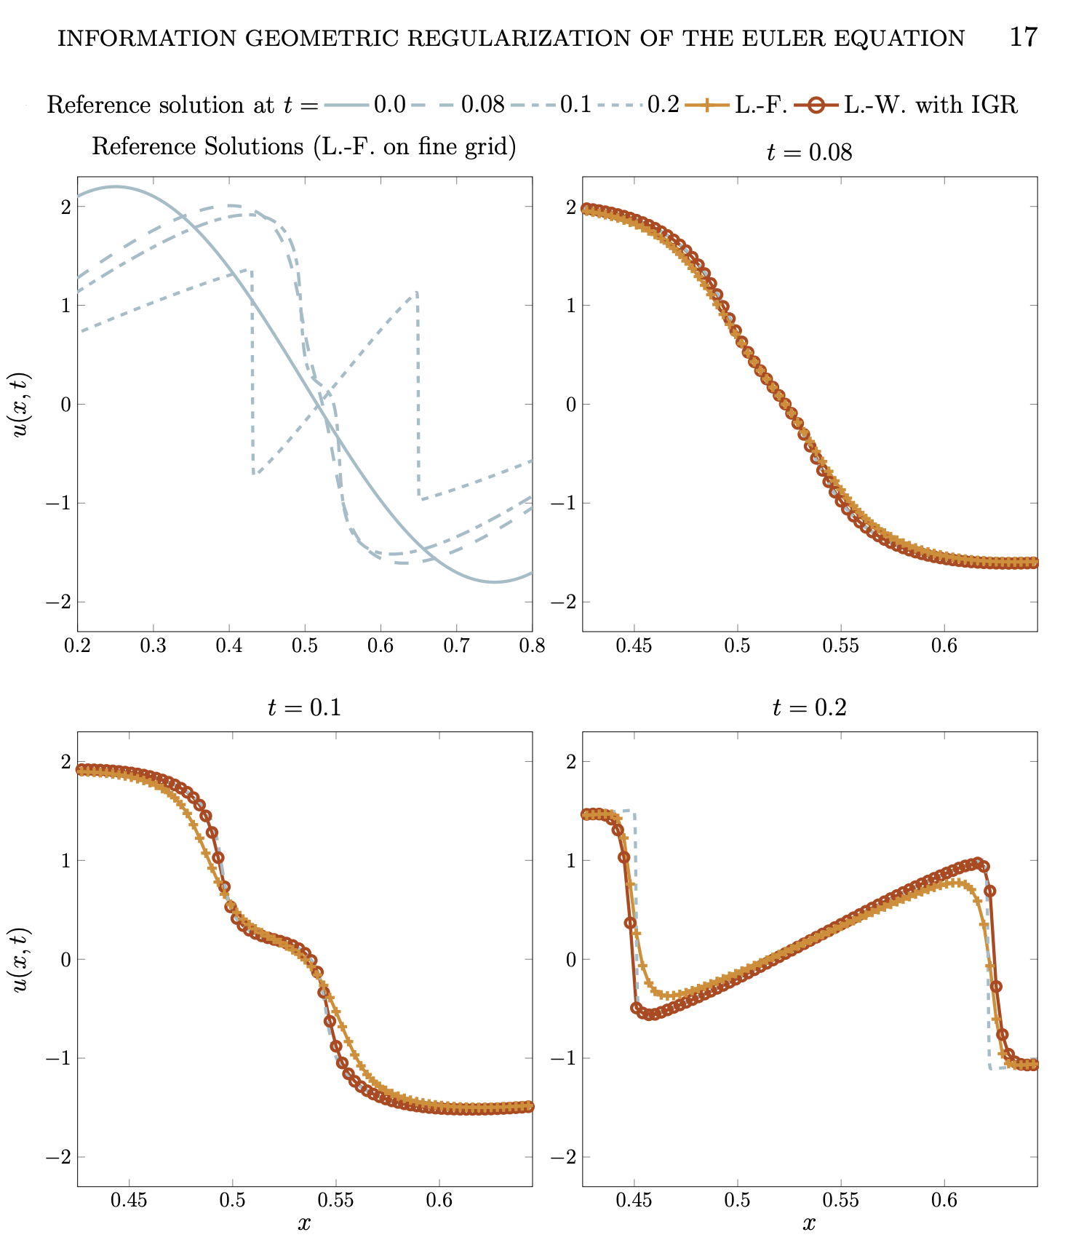
Some numerics: Euler
Reg. Euler with L.-W. has correct peak velocity

Slide 48
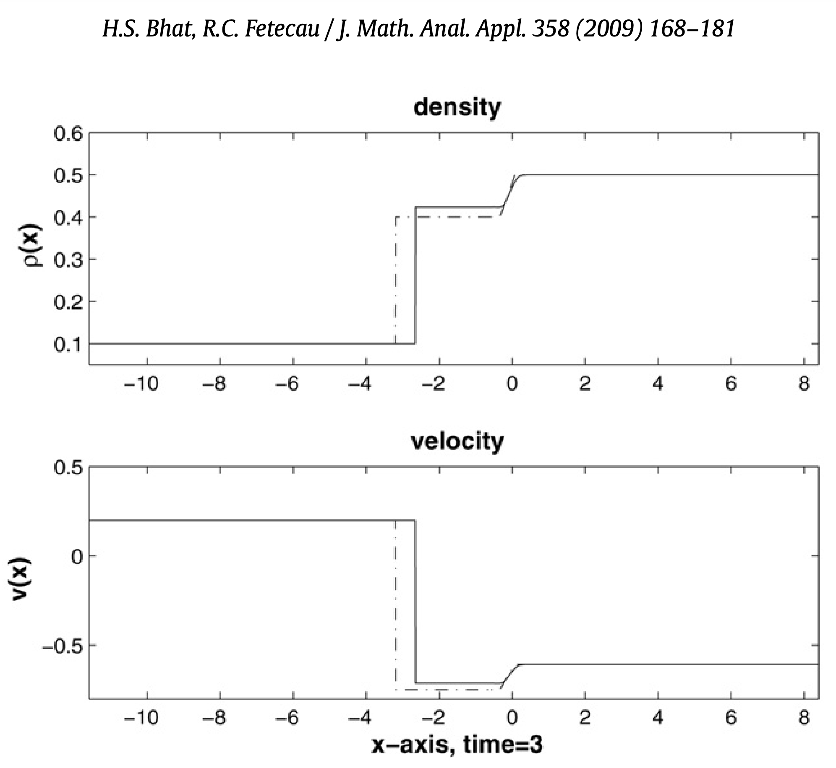
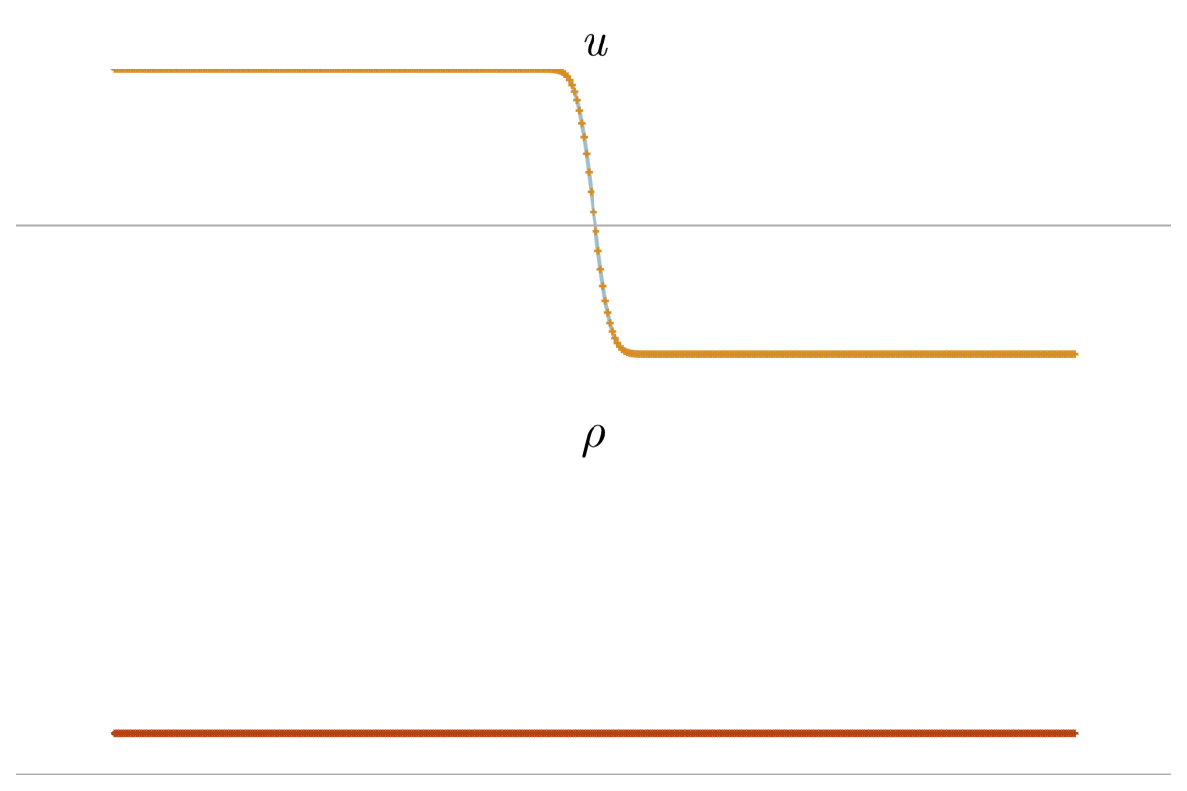
Some numerics: Euler
Maintain correct shock speed, overcome drawback of Leray-type regularization
Hamiltonian Reg. [Guelmame et al. 2022] of unidimensional Euler achieves this as well

Slide 49
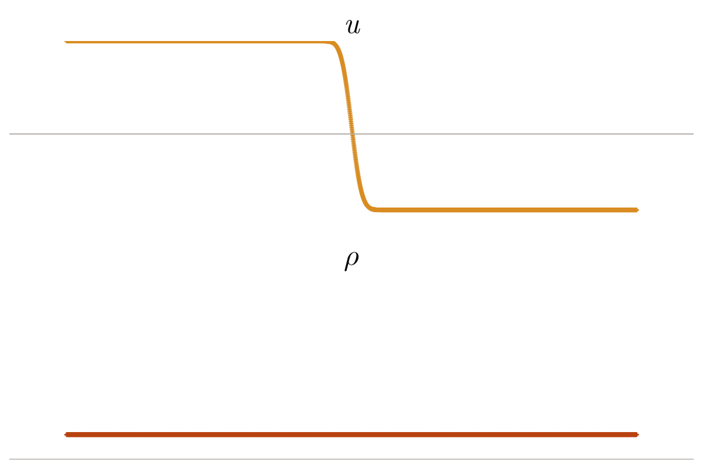

Some numerics: Euler
Decreasing $α$ seems to lead to convergence

Slide 50
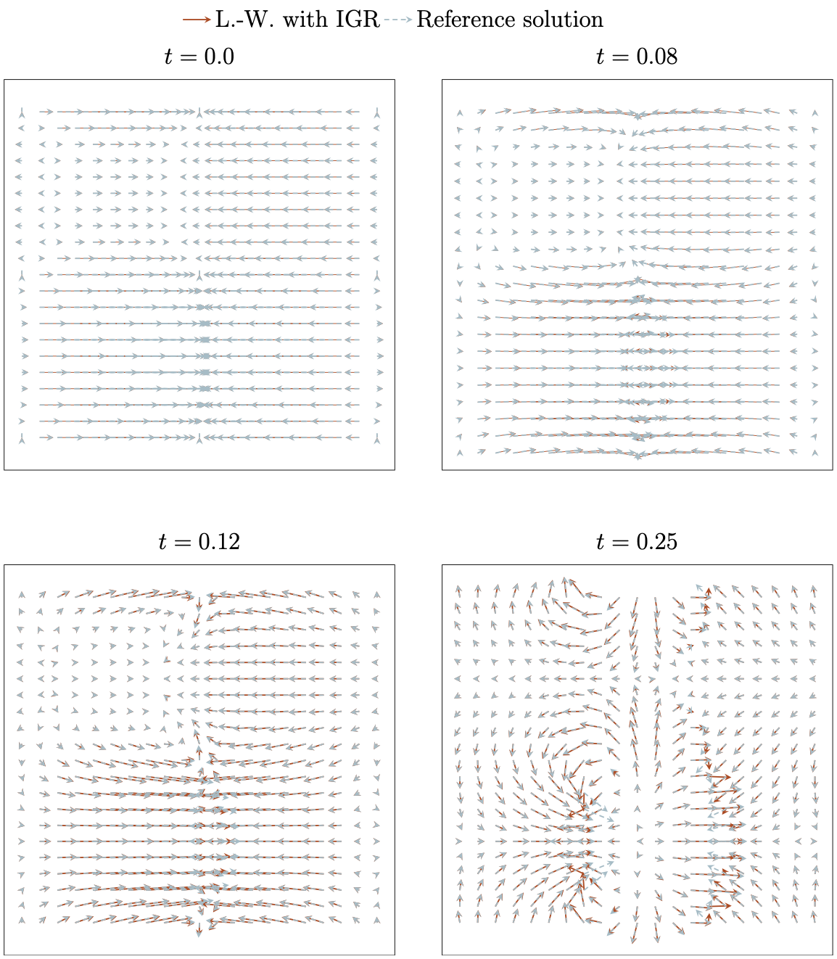
Bidimensional Case
Good agreement with nominal solution up to some points close to shock

Slide 51
Physical Interpretation of IGR
First perspective: Shocks as a contact pb.
Slogan: dissipate energy
when self-penetration of
matter is imminent.
Log determinant provides
differentiable description

Slide 52
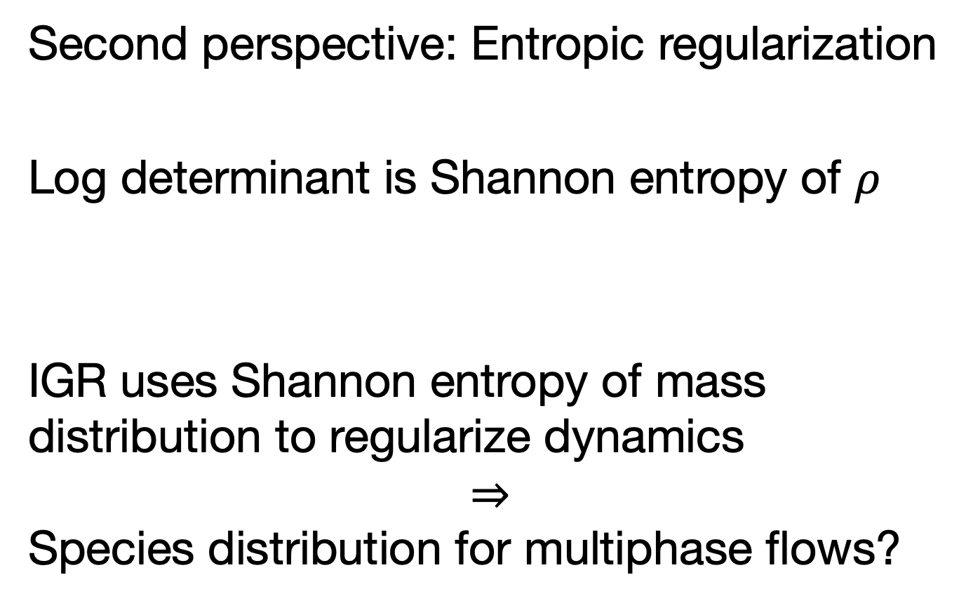
Physical Interpretation of IGR
Second perspective: Entropic regularization
Log determinant is Shannon entropy of $ρ$
IGR uses Shannon entropy of mass distribution to regularize dynamics
$$⇒$$
Species distribution for multiphase flows?

Slide 53
Summary
Propose regularized compressible Euler eqn by modifying geometry of diffeomorphisms.
Can maintain sharp but nonsingular shocks with correct shock speed.
Numerous future work: Numerics, proof of convergence, adjoint state methods …

Slide 54
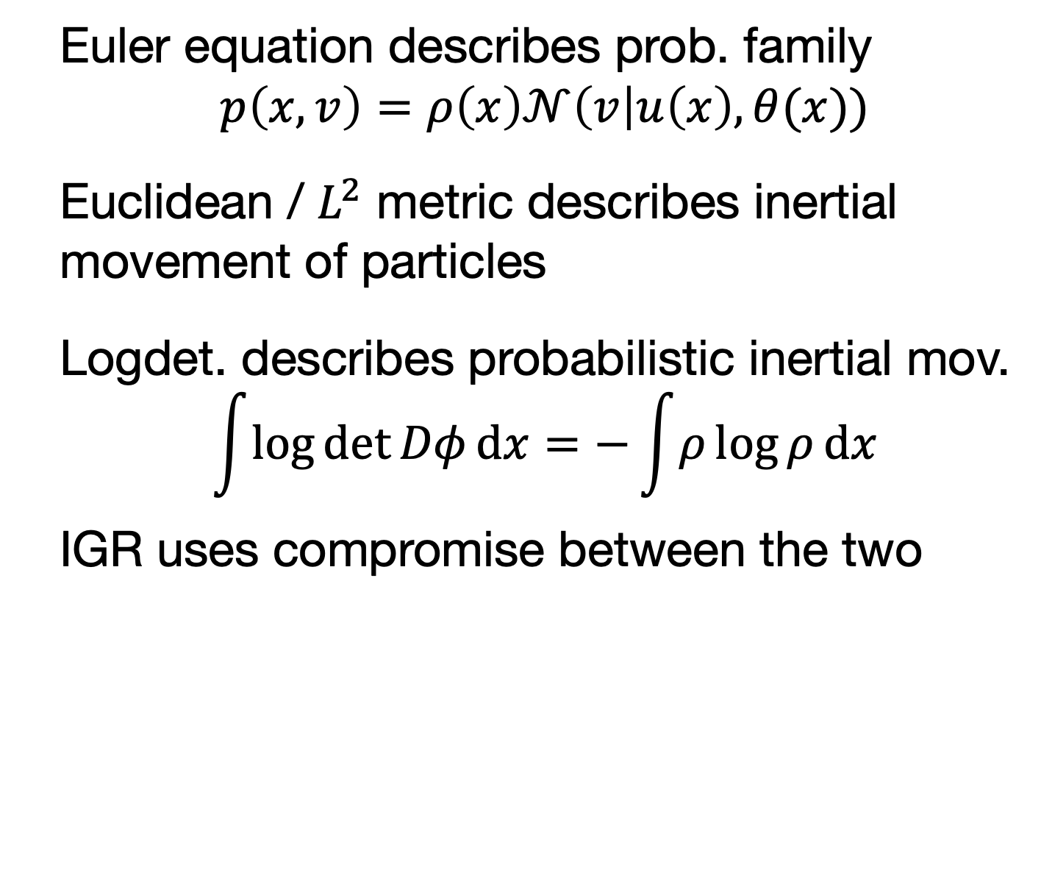
Outlook: Information Geometric Mechanics
Euler equation describes prob. family
$$p\left(x, v\right)=ρ\left(x\right)𝒩\left(v\right|u\left(x\right), θ(x))$$
Euclidean / $L^{2}$ metric describes inertial movement of particles
Logdet. describes probabilistic inertial mov.
$$\int{\log{\det{Dφ}}dx}=−\int{ρ}\log{ρ}dx$$
IGR uses compromise between the two

